Slide 1
Topic: simultaneous equations
EQ: How do I solve simultaneous equations algebraically, without graphing them?

Slide 2
RECAP

Slide 3
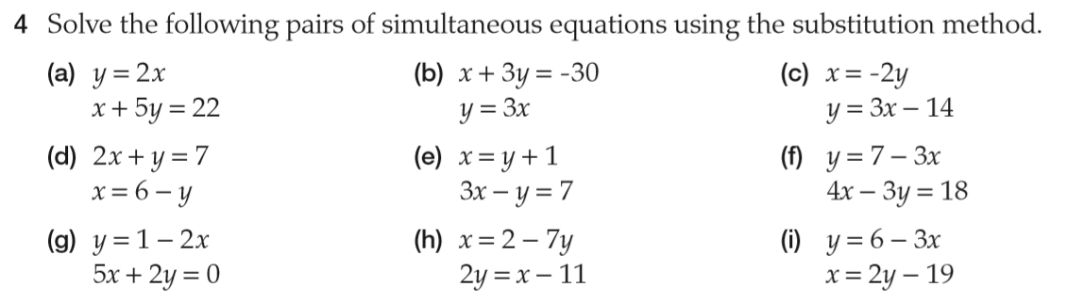
Part 1 → substitution method

Slide 4
Part 2 - Elimination
Step 1:
Eliminate one of the variables
By adding the two equations together the xs cancel out
x+-x = 0
→eliminating the x variable
x + 4y = 12
-x + y = 8
5y = 20
y = 4
x + 4(4) = 12
x + 16 = 12
x = -4
Now that we know what y is, we can substitute it back into one of the equations and solve for x

Slide 5
Part 2 - Elimination
Step 1:
Eliminate one of the variables
By multiplying the entire second equation by 2 the xs will now cancel out when added togther
2x+-2x=0, eliminating the x variable
2x + 3y = 9
-x + y = 3
2x + 3y = 14
-2x + 2y = 6
5y = 20
y = 4
-x + 4 = 3
-x = 3 – 4
-x = -1
x = 1
Sometimes just adding or subtracting the equations doesn’t immediately eliminate one of the variables
Now that we know what y is, we can substitute it back into one of the equations and solve for x

Slide 6
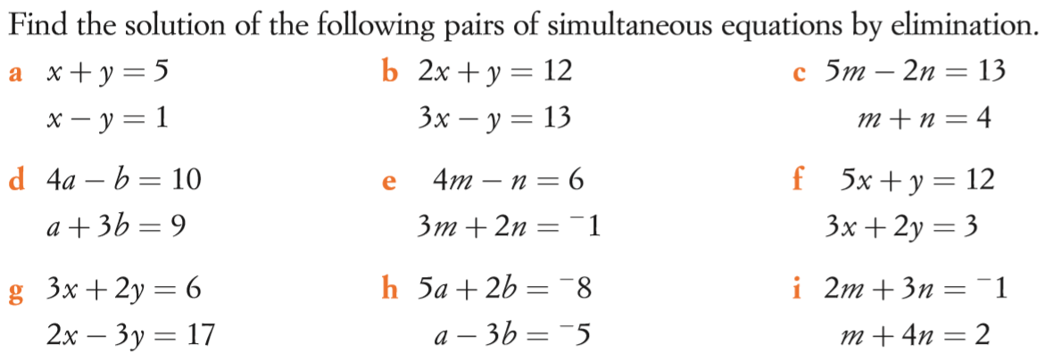
Part 2 - Elimination

